Slide 1
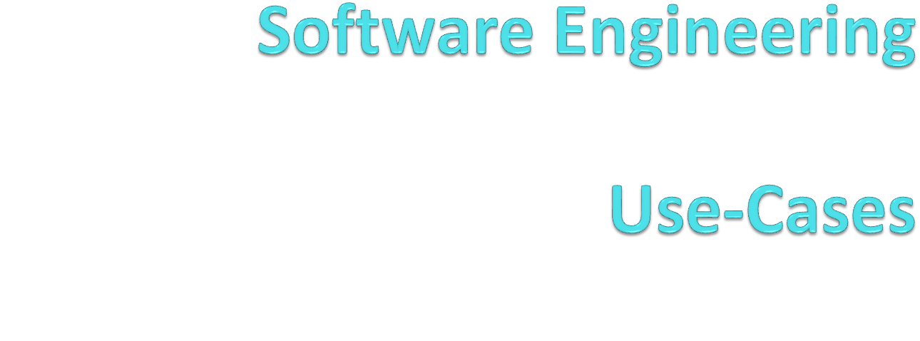
By:
Umair Azfar Khan

Slide 2
Unified Modeling Language
Natural languages are less precise than computer languages
Computer languages are highly technical and are used to define the system
UML bridges the gap between the programming languages and the natural languages
It is a standardized language that is used by the industry

Slide 3
What is UML?
It is a visual language for modeling and communicating about systems through the use of diagrams and supporting text.

Slide 4
Advantages of UML
It's a formal language
  Each element of the language has a strongly defined meaning, thus avoiding confusion
It's concise
  The entire language is made up of simple and straightforward notation.
It's comprehensive
  It describes all important aspects of a system.

Slide 5
Advantages of UML
It's scaleable
  Where needed, the language is formal enough to handle massive system modeling projects, but it also scales down to small projects, avoiding overkill.
It's built on lessons learned
  UML is the culmination of best practices in the object-oriented community during the past 15 years.
It's the standard
  UML is controlled by an open standards group with active contributions from a worldwide group of vendors

Slide 6
Defining UML
Alphabet (Recall Automata)
  Includes rectangles, lines and other graphical elements
  Strings
Words – Belong to two different categories
  Concepts
    Solid outlined rectangles or symbols labeled with a name
  Relationships between concepts
    Line paths between concepts labeled with a name
When you combine concepts and relationships, you combine UML words to make UML sentences

Slide 7
Defining UML
Sentences
  Sentences are a grouping of words from a language’s vocabulary that defines a grammatical unit of meaning containing a subject and an expression about the subject.
UML sentences are diagram fragments or very simple diagrams

Slide 8
Example
A relationship is read from top to bottom or from left to right
Otherwise it has solid black arrows showing the relationship
Team
Execute
Project

Slide 9
Manager
Manage
Lead
Team
Project

Slide 10
Team
Manager
Project
Lead
Manage

Slide 11
Philippe Kruchten’s 4+1 view model
UML diagrams are broken into perspectives and views. By combining these views we define the overall model.
Logical View
Process View
Use Case View
Physical View
Development View

Slide 12
Logical view
Describes the abstract descriptions of a system's parts.
Used to model what a system is made up of and how the parts interact with each other.
The types of UML diagrams that typically make up this view include class, object, state machine, and interaction diagrams.

Slide 13
Process view
Describes the processes within your system. It is particularly helpful when visualizing what must happen within your system.
This view typically contains activity diagrams.

Slide 14
Development View
Describes how your system's parts are organized into modules and components. It is very useful to manage layers within your system's architecture.
This view typically contains package and component diagrams.

Slide 15
Physical View
Describes how the system's design, as described in the three previous views, is then brought to life as a set of real-world entities.
The diagrams in this view show how the abstract parts map into the final deployed system. This view typically contains deployment diagrams.

Slide 16
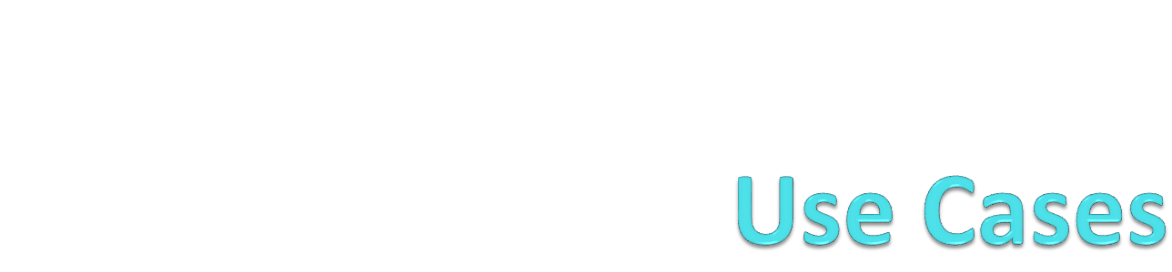
Lecture 02

Slide 17
Use Case View
Describes the functionality of the system being modeled from the perspective of the outside world.
All of the other views rely on the use case view to guide them. That's why the model is called 4+1.
This view typically contains use case diagrams, descriptions, and overview diagrams.

Slide 18
Starting UML
Note:
A note is used to write additional comments that cannot be put in a UML diagram. Notes are pictured as a folded rectangle notation

Slide 19
Stereotypes
Stereotypes signify a special use or intent and can be applied to almost any element of UML notation. Stereotypes modify the meaning of an element and describe the element's role within your model.
Administrator

Slide 20
Stereotypes
Stereotypes is not always represented by an icon, a stereotype name can also be represented by guillemots at either end of the stereotype name.
There can be more than one stereotypes as well.
<<actor>> Administrator
<<actor, person>> Administrator

Slide 21
Tagged Values
Stereotypes can contain extra information that relates to the element to which they are applied. This extra information is specified using tagged values .
A tagged value is drawn on a diagram using a similar notation to notes, but the folded rectangle contains the name of any stereotypes and settings for any associated tagged values.
<<form>> LoginPage
<<form>>
Validate = true

Slide 22
A Use Case
A use case is a case (or situation) where your system is used to fulfill one or more of your user's requirements; a use case captures a piece of functionality that the system provides.
Use cases specify only what your system is supposed to do, i.e., the system's functional requirements. The non-functional requirements often include performance targets and programming languages, etc.

Slide 23
Capturing a System Requirement
Requirement A.1
The content management system shall allow an administrator to create a new blog account, provided the personal details of the new blogger are verified using the author credentials database.

Slide 24
What about shall or should?
Shall requirement must always be fulfilled as it is required of the system
Should requirement, although desirable is not necessary to be implemented

Slide 25
First step is to find actors
Actor is a name given to a thing that interacts with your system. Thus finding the actors in the requirement should be the first step.
An actor is drawn in UML notation using either a "stick man" or a stereotyped box and is labeled with an appropriate name.
<<actor>> Administrator
Administrator

Slide 26
Actors
From this requirement, the two actors that we come up with are administrator and the author credentials database
Administrator
Author credential
database

Slide 27
Refining Actors
User
Administrator

Slide 28
Second Step
The next step is to find use cases where the system is being used to complete a specific job for an actor
A use case in UML is drawn as an oval with a name that describes the interaction that it represents
Create a new blog

Slide 29
What is a good Use-Case?
A use case is something that provides some measurable result to the user or an external system.
Any piece of system behavior that meets this simple test is likely to be a good candidate for a use case

Slide 30
Communication Line
A communication line connects an actor and a use case to show the actor participating in the use case.
The purpose of a communication line is to show that an actor is simply involved in a use case, not to imply an information exchange in any particular direction or that the actor starts the use case
Create a new blog
Administrator
Author credential
database

Slide 31
System Boundaries
To show your system's boundary on a use case diagram, draw a box around all of the use cases but keep the actors outside of the box
Content Management
System
Create a new blog
Administrator
Author credential
database

Slide 32
Use Case Description
Every use case must have a text based description to explain its purpose, for example:
Related Requirements
Some indication as to which requirements this use case partially or completely fulfills.
Goal In Context
The use case's place within the system and why this use case is important.
Preconditions
What needs to happen before the use case can be executed.

Slide 33
Capturing a System Requirement
Requirement A.2
The content management system shall allow an administrator to create a new personal Wiki, provided the personal details of the applying author are verified using the Author Credentials Database.

Slide 34

Capturing a System Requirement
Content Management
System
Create a new blog
Administrator
Create a new Wiki
Author credential
database

Slide 35
The <<include>> Relationship
Relationships between use cases breaks your system's behavior into manageable chunks
It does not add anything new to your system

Slide 36
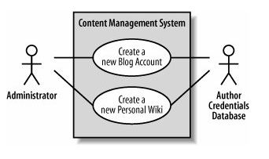
Revisiting Requirement A.2
We see that both the use cases have some redundancy
This repetitive behavior shared between two use cases is best separated and captured within a totally new use case

Slide 37
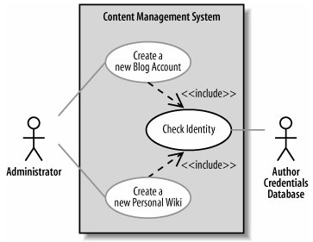
This new use case can then be reused by the Create a new Blog Account and Create a new Personal Wiki use cases using the <<include>> relationship

Slide 38
The <<include>> relationship declares that the use case at the head of the dotted arrow completely reuses all of the steps from the use case being included.
You can also see in that the Check Identity use case is not directly connected to the administrator actor; it picks this connection up from the use cases that include it. However, the connection to the Author Credentials Database is now solely owned by the Check Identity use case.

Slide 39
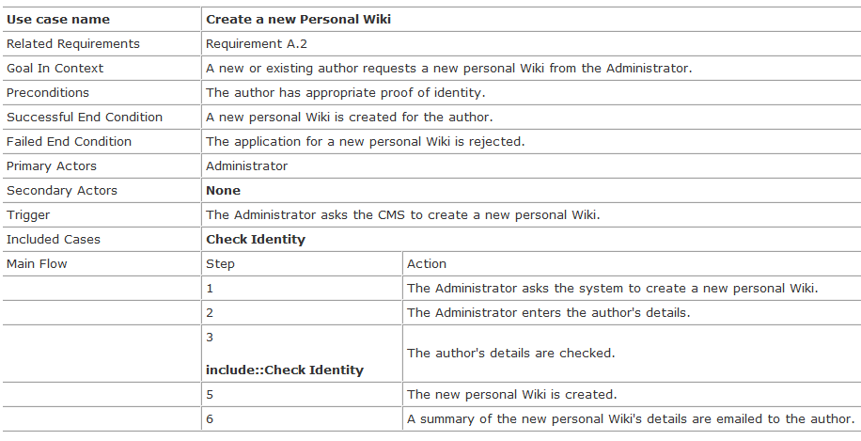
The Create a new Personal Wiki use case description

Slide 40
Why do this?
Reuse using <<include>> removes the need for tedious cut-and-paste operations between use case descriptions, since updates are made in only one place instead of every use case.
The <<include>> relationship gives you a good indication at system design time that the implementation of Check Identity will need to be a reusable part of your system.

Slide 41
Special Cases
Sometimes you'll come across a use case whose behavior can be applied to several different cases, but with small changes
Unlike the <<include>> relationship, which allows you to reuse a small subset of behavior, this is applying a use case with small changes for a collection of specific situations
This is termed as “Use Case Generalization”
A more common term is called “Inheritance”

Slide 42
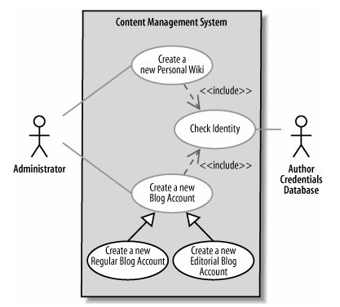
Use case inheritance shows that one use case is a special type of another use case

Slide 43
The <<extend>> Relationship
The <<extend>> relationship shows that a use case might completely reuse another use case's behavior, similar to the <<include>> relationship, but that this reuse was optional and dependent either on a runtime or system implementation decision.

Slide 44
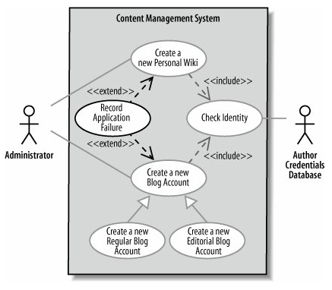
The <<extend>> Relationship

Slide 45
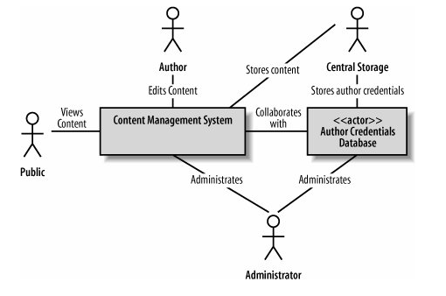
Use Case Overview Diagram

Slide 46
The End

